Slide 1
Software Development in the Next Decade: Beyond the Dichotomy of Open-Source and Corporate Worlds
Jinglei Ren¹ and Hezheng Yin²
Persper Foundation
¹ Microsoft Research
² UC Berkeley
(Advised by Armando Fox from UC Berkeley)

Slide 2
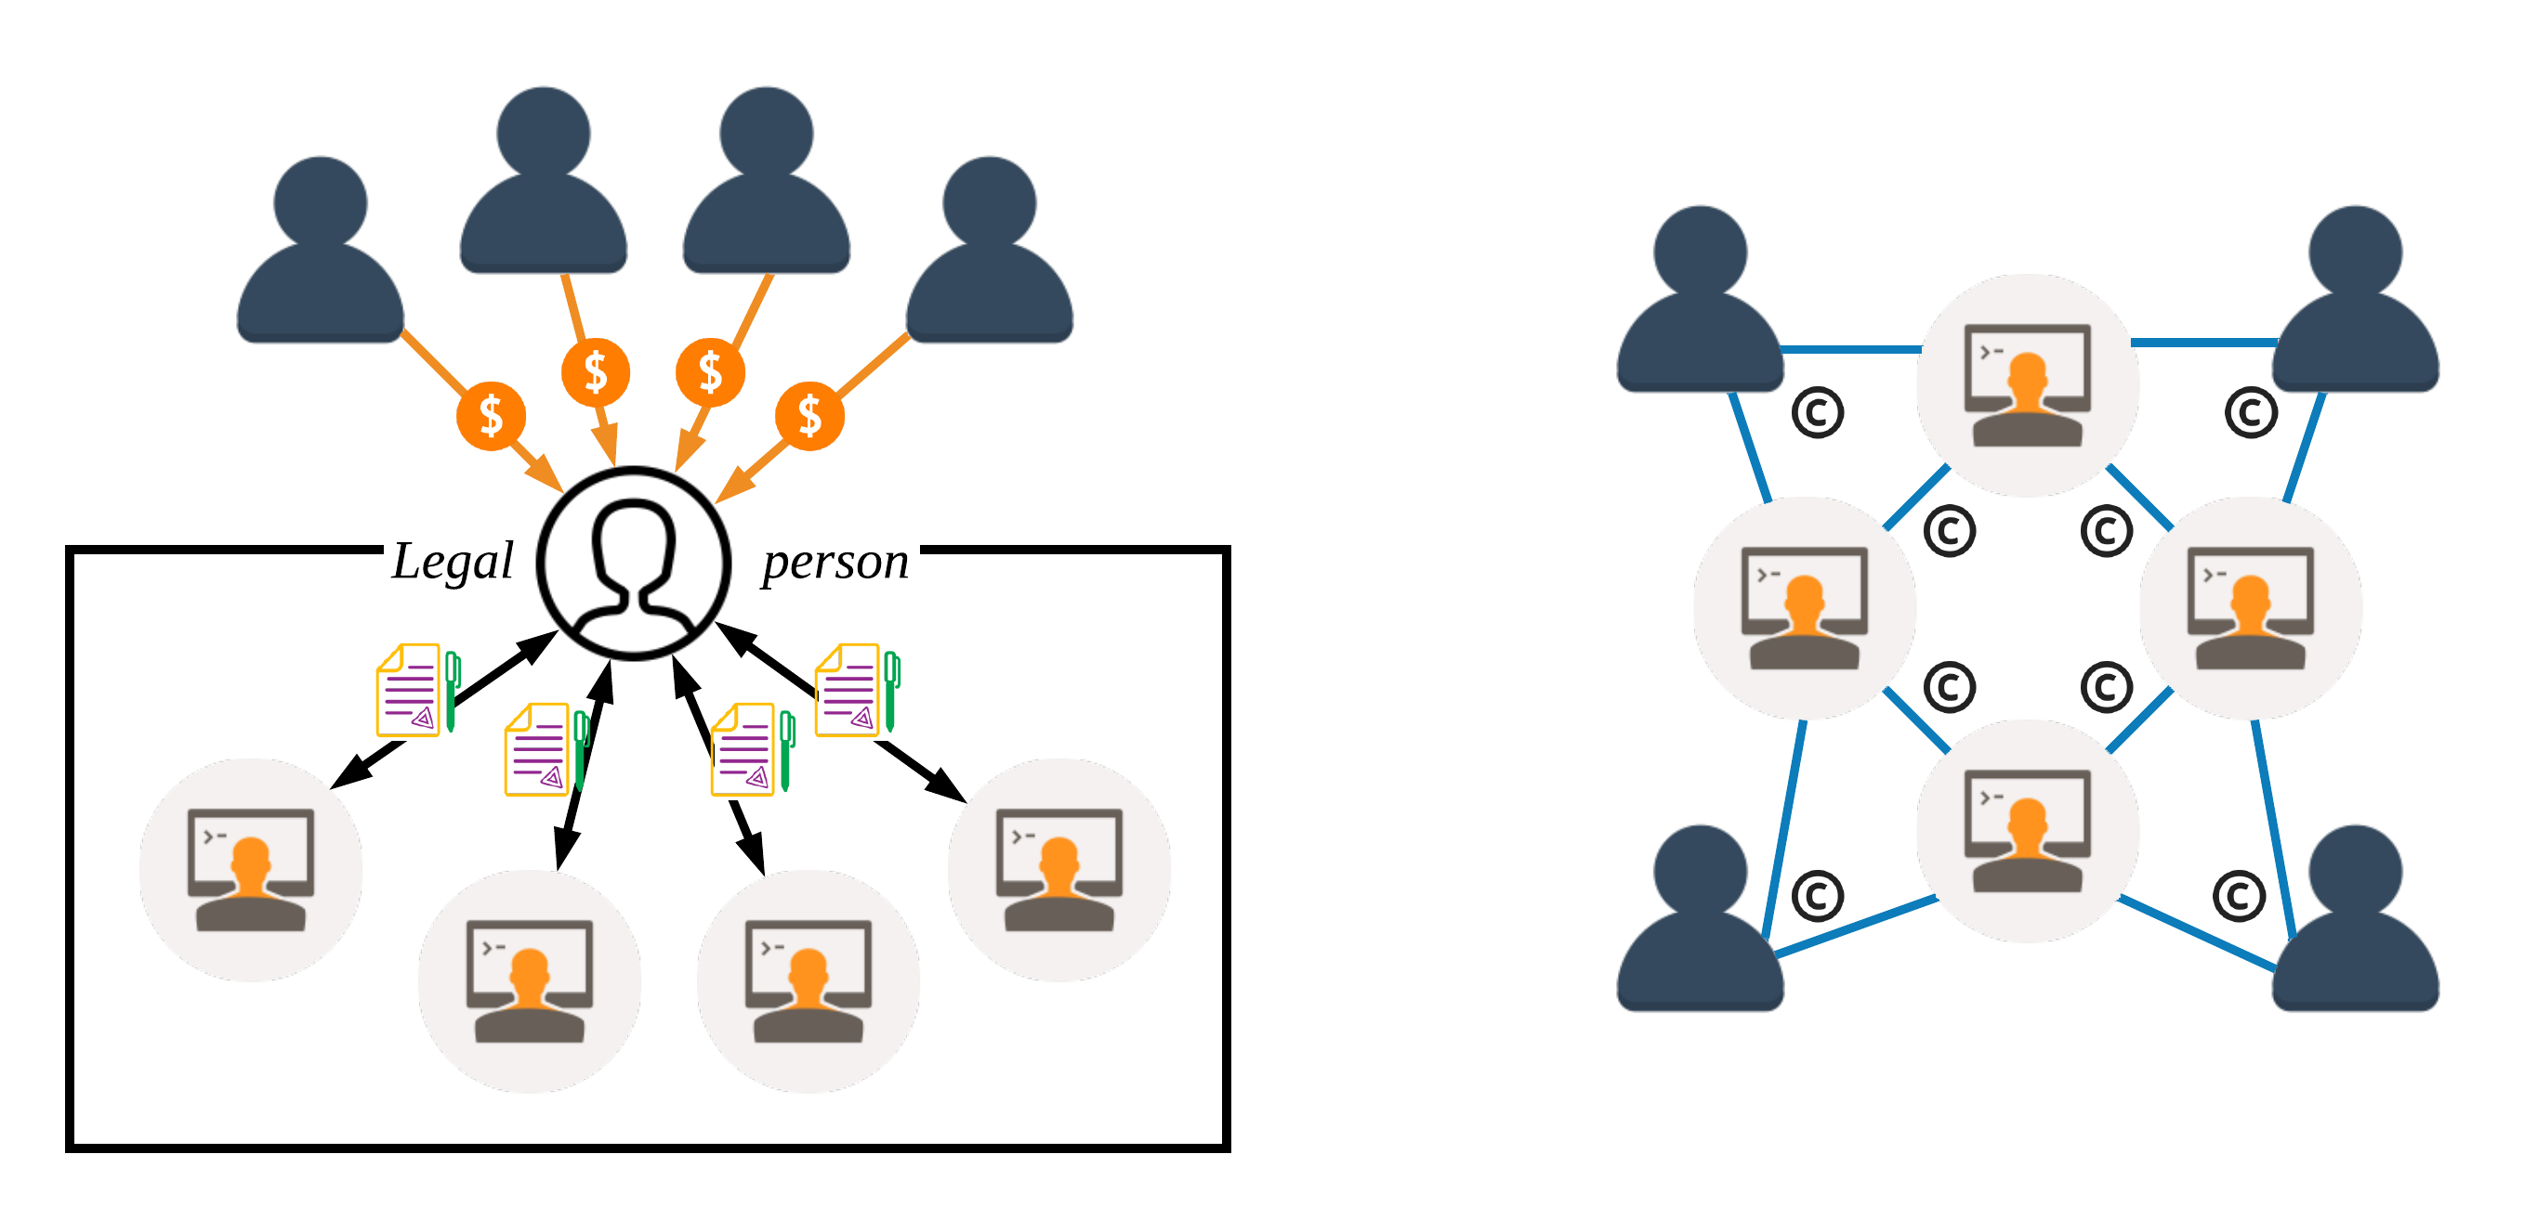
Corporate World vs. Open-Source World
Users
Developers

Slide 3
Classic Open Innovation
H. Chesbrough, Open Innovation: Renewing Growth from Industrial R&D, 10th Annual Innovation Convergence, Sept 27, 2004.
Notes:
One example: interaction with open source

Slide 4
Why the dichotomy of the two worlds?

Slide 5
Overview
Reasons leading to the two worlds
Information asymmetry
Transaction cost
Imperfect solutions
Technologies with potentials
Assessing the value of code contributions ➟ Information asymmetry
Decentralized value sharing ➟ Transaction costs
Virtual shareholding: Beyond the dichotomy
Value-shared open source
Virtual open corporation
Virtual closed corporation

Slide 6
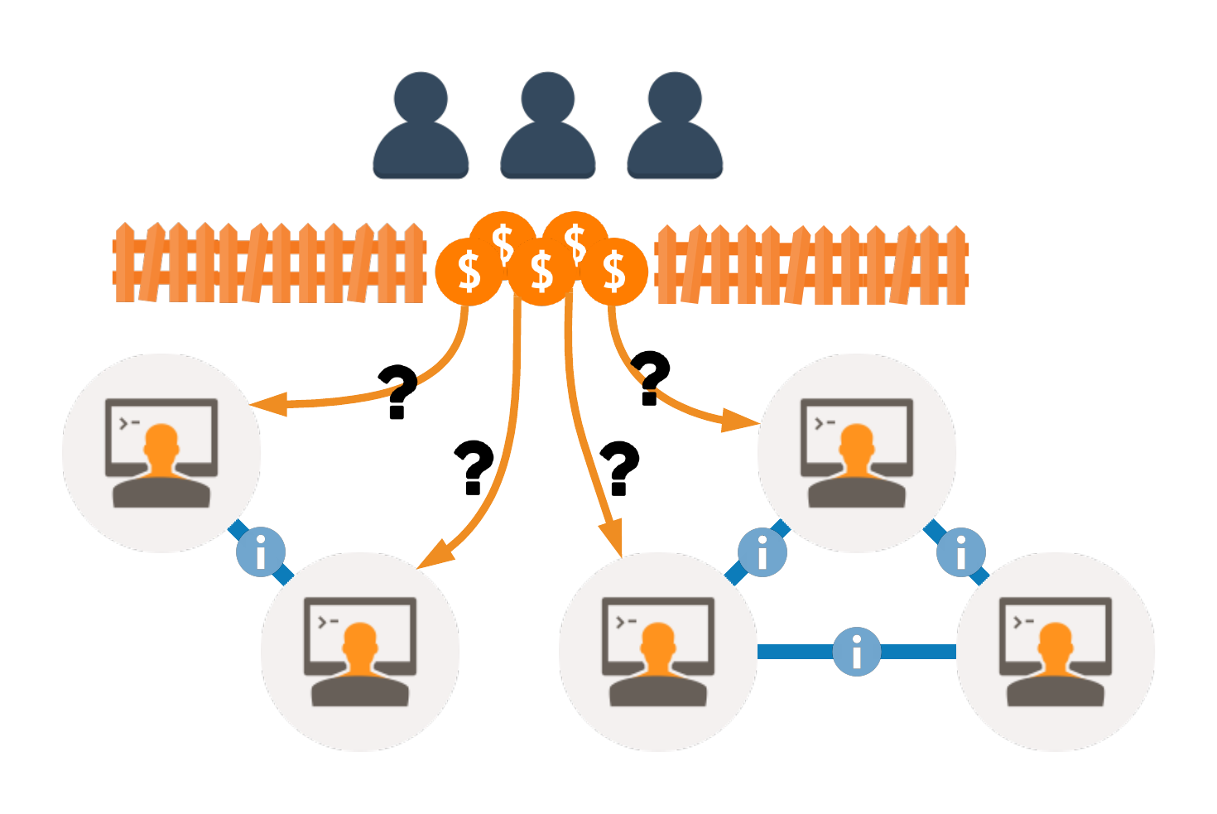
Information Asymmetry
How to allocate value?
Users don't understand developers' work.
Individual developers lack a consistent global view.
Practice in corporation: Corporate structures
Practice in open source: Relinquish the value

Slide 7
Transaction Cost
Suppose n developers and m users
# of contracts ≅ n² + nm
Dynamics of the network
Turnover of developers
Churn of users
Practice in corporation: Legal person
Practice in open source: Open source license
Licensed under Shutterstock Standard License

Slide 8
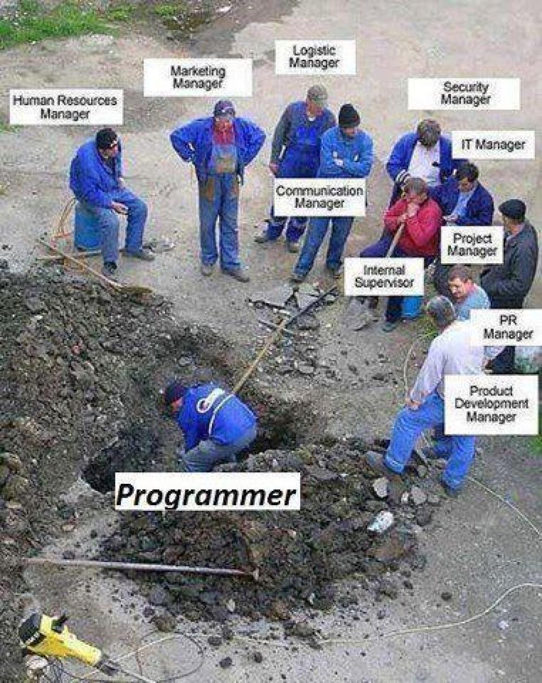
Corporate Issues
Unfair value allocation
Bias on personality and social relationships
Why employees leave: "low salary" (69.44%); "overworked" (63.12%); “lack of recognition or reward” (45.24%); “boss didn’t honor commitments” (43.49%).
Unnecessary operating overhead
Your code is not yours!

Slide 9

Open-Source Issues
Financial crisis
“The worst vulnerability found... since commercial traffic began to flow on the Internet.”
-- Joseph Steinberg, Forbes.
“Free Can Make You Bleed.”
-- John Walsh, SSH Communications Security.

Slide 10


Open-Source Issues
No general method for value allocation
“… if he took some of the money, then it seemed fair for other contributors … [to take some].”
-- Evan You, creator of vue.js.
Linus’ Law:
“given enough eyeballs, all bugs are shallow”

Slide 11
Assessing the Value of Code Contributions
Various definitions of value (e.g., market price)
Development value
Development effort embodied in a code contribution
Development effort that the code contribution saves
Abstract development effort in general
Assume an average developer
Similar to the abstract human labor in classic economics
A coherent concept for building the model
Notes:
Code

Slide 12
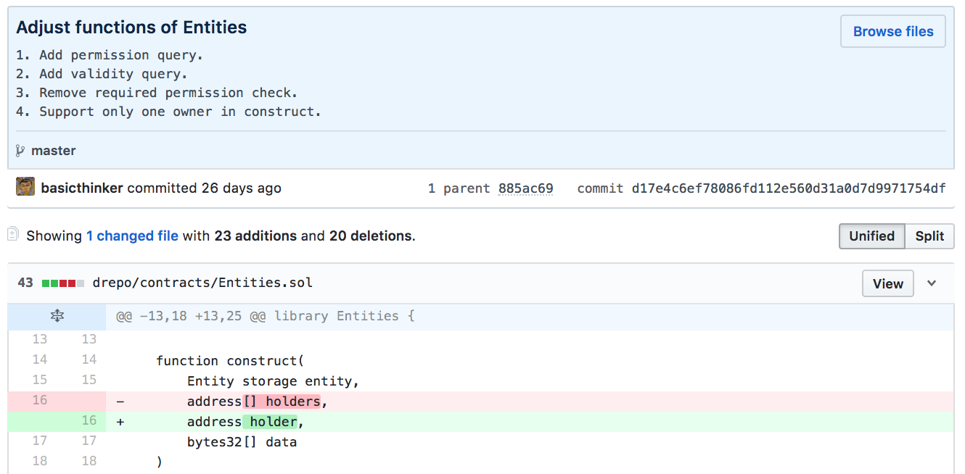
Assessing the Value of Code Contributions
Basic metric of development effort
Commits, additions, and deletions
Our metric: # of changed LOCs

Slide 13
Assessing the Value of Code Contributions
Commit-specific calibration
E.g.: a fix to a very hard-to-track bug
A few lines solve a huge issue!
Such a commit requires an large effort of an average developer
Program analysis and natural language processing/machine learning
Code structure ➟ Reuse of code
Commit messages + large developer surveys ➟ Commit-specific calibration

Slide 14
Decentralized Value Sharing
A blockchain is an immutable ledger of user-defined records
Smart contracts
E.g., “store received tokens in the current account; upon the 1st day of every month, divide the balance by total shares and transfer dividends to shareholders.”
Transparent
Unstoppable
Tamper-proof
Reduce the cost of trust-building, contracting and enforcement

Slide 15
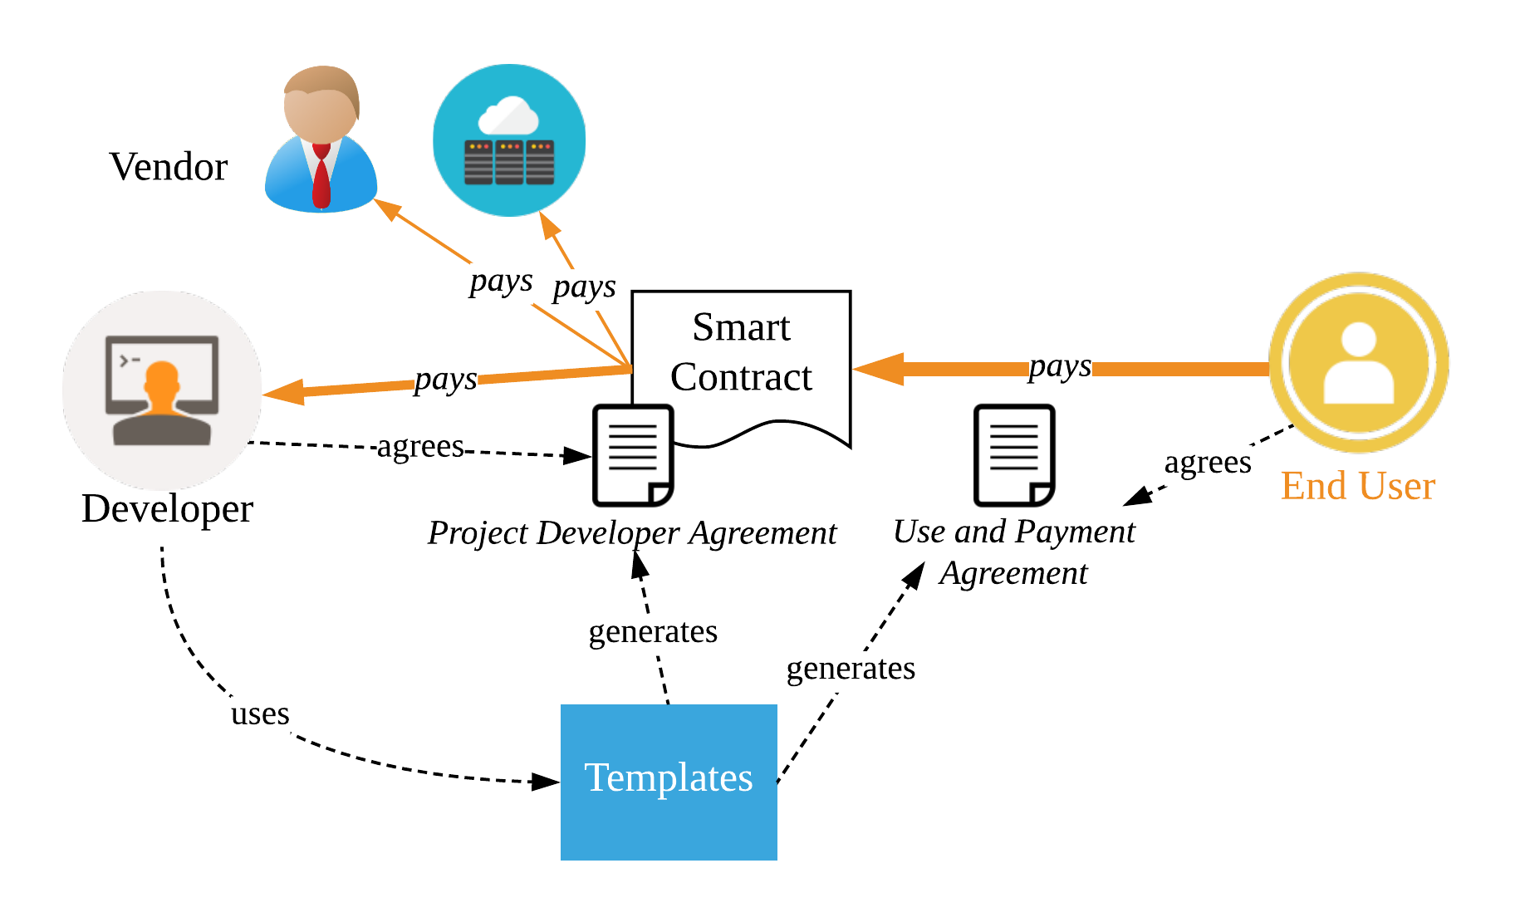
Decentralized Value Sharing
Framework/workflow
Value assessment and value sharing are integral.

Slide 16
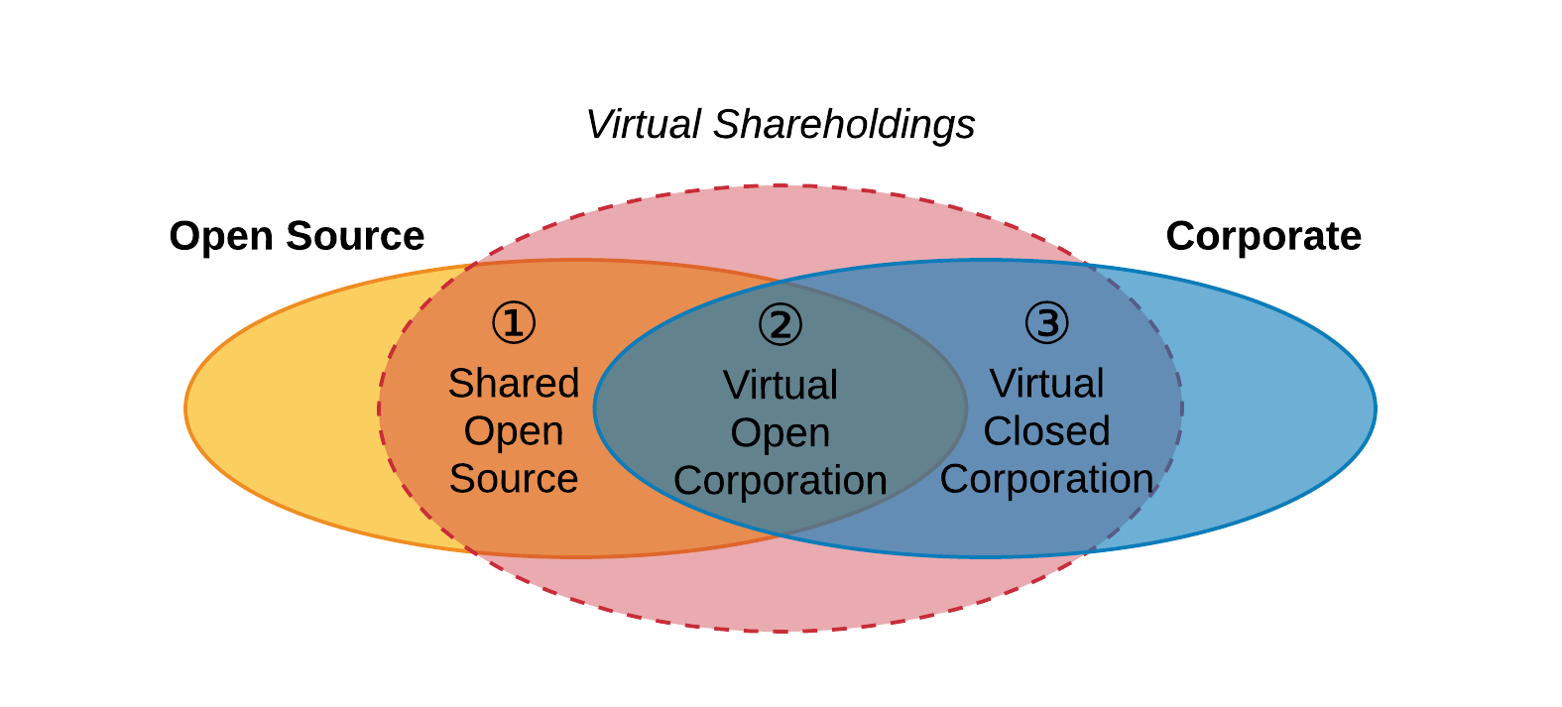
Virtual Shareholding: Beyond the Dichotomy

Slide 17


Virtual Shareholding: Beyond the Dichotomy
 | Traditional open source | Traditional corporation | Value-shared open source | Virtual open corporation | Virtual closed corporation
Financial risk
Fair allocation
Global talent
Long-term return

Slide 18
Outlook: Open Research Questions
Gaming behavior and counteraction
Influence on the project governance
Real application!
Persper Foundation
Sponsor selected open source projects with $10,000 per month for 6 months.
How would developers react?

Slide 19
Backup
Non-code contributions
“The most important feature of Linux, however, was not technical but sociological.”
—Eric S. Raymond, The Cathedral & the Bazaar, 2001.

Slide 20
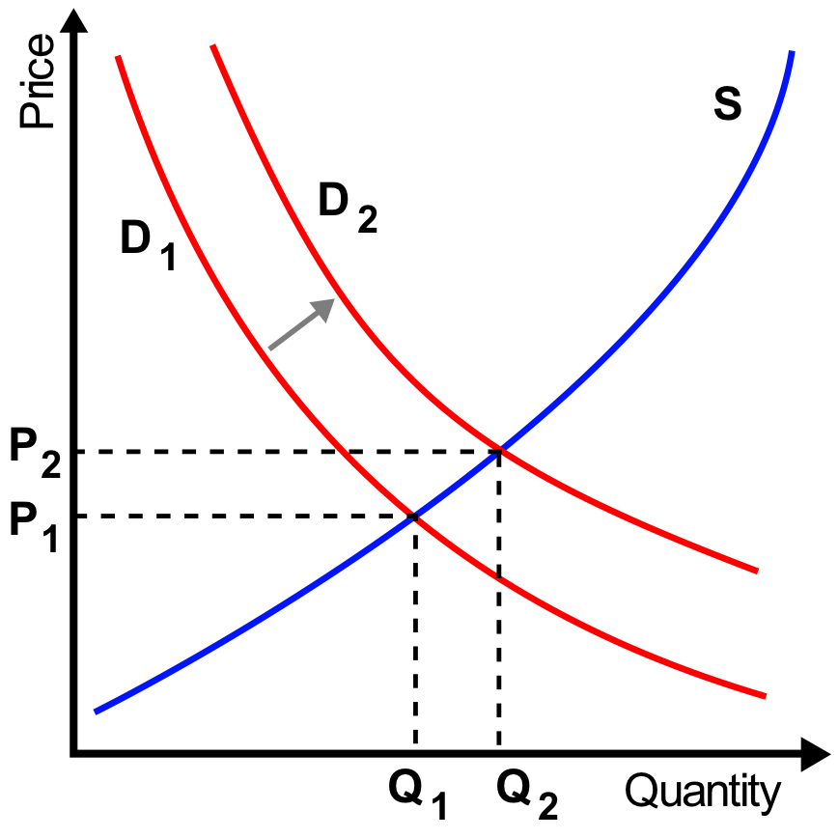
Backup
Other incentives than money

